Slide 1

Security Framework
Predict – Preempt – Protect

Slide 2
Definitions
Framework
Provide guidance on how to build Individual architectures that will be useful to a diverse set of individuals
Architecture
Conceptual Construct
Tool to help individuals understand complex items
It expresses enterprise structure (form) and behaviour (function)
Security Program
It is a framework made of many entities working together to provide a protection level for an environment
A security program should work in layers
Security via obscurity is not a healthy protective mechanism

Slide 3
ISO27000 Security Program
Outlines how an information security management system should be built and maintained
Provides guidance to design, implement and maintain policies, procedures, and technologies to manage risks to the sensitive information assets of an organization
Its based on PDCA model
Some key ISO27000 standards
ISO27001 – ISMS requirements
ISO27002 – Code of practice for ISMS
ISO27005 – Risk Management
ISO27031 – Business continuity

Slide 4
Enterprise Architecture
Two important key aspects of an Enterprise Architecture
Identifying the stakeholders
people who will be looking at it and using it
Developing Views
How the information that is most important to different stake holders will be illustrated in the most useful manner
Architecture allows not only to understand the business from different views, but also understand how a change takes place at one level will affect items at all other levels
Keep building a House as a reference when understanding this

Slide 5
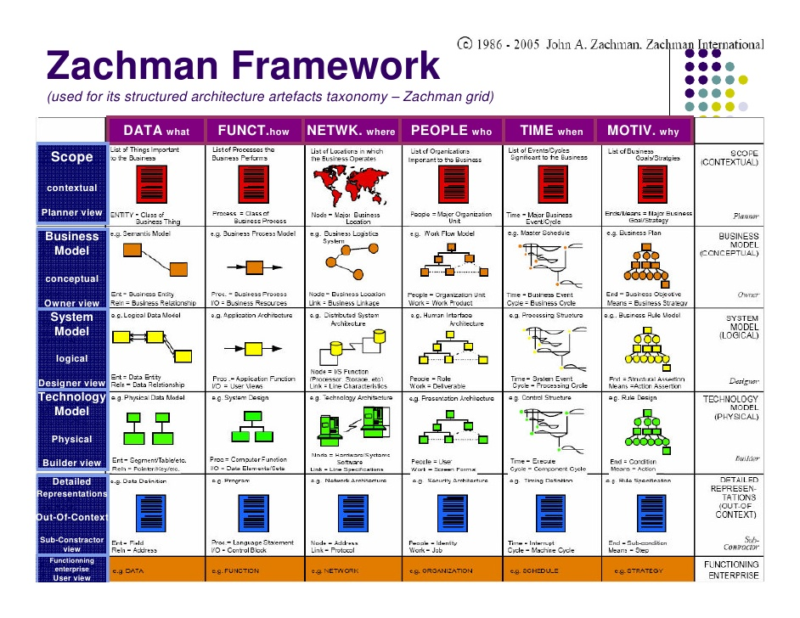
Zachman Architecture Framework
First architecture Framework
This is not a security oriented framework
Uses six basic communication interrogatives intersecting with different perspectives
Important rule is that each row should describe the enterprise in its entirety from that rows’ perspective

Slide 6
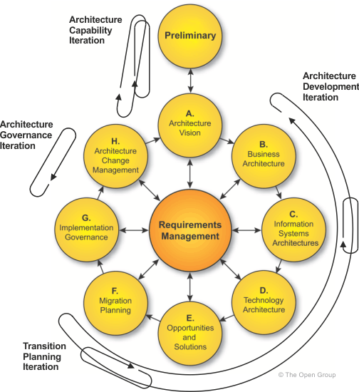
The Open Group Architecture (TOGAF)
Has its origins from US DoD
Provides an approach to design, implement, and govern an enterprise Information architecture
Used to develop the following architecture types
Business Architecture
Data Architecture
Applications Architecture
Technology Architecture
Uses Architecture Development Method to create Individual architectures
ADM is an iterative and cyclic process that allows requirements to be continuously reviewed and updated

Slide 7
Enterprise Security Architecture
Subset of Enterprise Architecture
Defines information security strategy that consists of layers of solutions, process, and procedures
It ensures that security efforts align with business practices in a standardized and cost-effective manner
For a successful ESA the following must be understood and followed
Strategic alignment
Business enablement
Process enhancement
Security effectiveness

Slide 8
Strategic Alignment
Business drivers and legal/regulatory requirements must be met by the Security architecture
Business Enablement
Core business processes are integrated into the security operating model
Process Enhancement
Security enterprise components must be integrated into the business processes to be effective
Security Effectiveness
Metrics, meeting SLA, achieving ROI, meeting set baselines, providing management dashboards
We can do new stuff
We can do stuff better

Slide 9
COBIT
It’s a model for IT Governance
Is a framework for governance and management developed by ISACA
It’s a holistic approach based on 5 key principles
Meeting stakeholder needs
Covering the enterprise end to end
Applying a single integrated framework
Enabling a holistic approach
Separating governance from management
Its ultimately linked to the stakeholders
It deals at the operational level
It specifies 17 enterprise and 17 IT specific goals
Majority of security compliance audit practices are based on COBIT

Slide 10
NIST 800-53
Developed by NIST
Outlines the controls that (US) agencies need to put into place to be compliant with the FISMA Act
There are many control categories addressed by this
They are management, operational, technical controls prescribed for an information system to protect CIA
As COBIT is for Private compliance needs, NIST is for US Government compliance needs

Slide 11
COSO Internal Control
It is a model for corporate governance
It deals at the strategic level
It was formed to provide sponsorship for an organization that studied deceptive financial reports and what elements lead to them
SOX is derived from COSO

Slide 12
ITIL
De facto standard on best practices for IT service management
Customizable framework
It provides the goals, the general activities necessary to achieve the goals, and the input/output values for each process required to meet the goals
It focuses more towards internal SLA between the IT department and the customer it serves (predominantly Internal functions)

Slide 13
Six Sigma / CMMI
It is a process improvement methodology
Six sigma – improves process by using statistical methods of measuring operational efficiency and reducing variations, defects and waste.
CMMI – develop structured steps that can be followed for an organization can evolve from one level to the next and constantly improve its processes and security posture.

Slide 14
